Slide 1
Week 2 Tutorial
Forecasting Financial Performance
Zirui Song
^{Feb 2025}

Slide 2
Questions
2-1
2-2
2-4
2-7

Slide 3
Knowledge review 1
The Time Value of Money (TVM) refers to the fact that a sum of money is worth more than now than in the future.
Why?
Opportunity cost of capital
Protection from inflation
Risk and uncertainty
Consumption preference

Slide 4

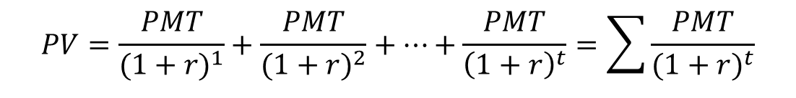
Knowledge review 1
To quantify TVM, we use discounting and compounding.
where:
PV = present value; FV = future value; PMT = periodic payment; r = discount rate; t = time period
$$PV=\frac{FV}{{(1+r)}^{t}}$$
$$PV=\frac{PMT}{{(1+r)}^{1}}+\frac{PMT}{{(1+r)}^{2}}+…+\frac{PMT}{{\left(1+r\right)}^{t}}=\sum{\frac{PMT}{{(1+r)}^{t}}}$$

Slide 5
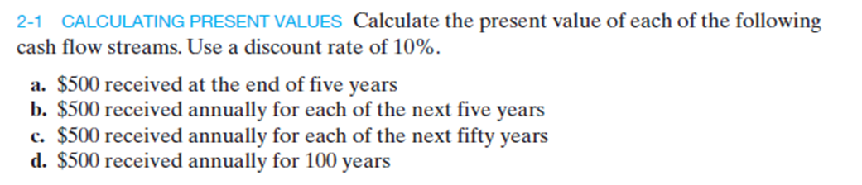
Question 1

Slide 6

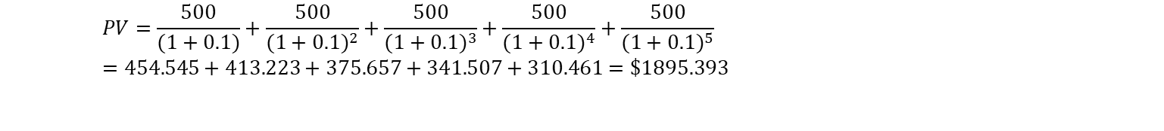
Question 1 (cont.)
a
b
c
d
$$PV=\frac{500}{{(1+0.1)}^{5}}=\$310.461$$
$$PV=\frac{500}{(1+0.1)}+\frac{500}{{(1+0.1)}^{2}}+\frac{500}{{(1+0.1)}^{3}}+\frac{500}{{(1+0.1)}^{4}}+\frac{500}{{(1+0.1)}^{5}} =454.545+413.223+375.657+341.507+310.461=\$1895.393$$
$$PV=\frac{500}{(1+0.1)}+\frac{500}{{(1+0.1)}^{2}}+\frac{500}{{(1+0.1)}^{3}}+\frac{500}{{(1+0.1)}^{4}}+\frac{500}{{(1+0.1)}^{5}}+…+\frac{500}{{\left(1+0.1\right)}^{49}}+\frac{500}{{\left(1+0.1\right)}^{50}}=\$4957.41$$
$$PV=\frac{500}{(1+0.1)}+\frac{500}{{(1+0.1)}^{2}}+\frac{500}{{(1+0.1)}^{3}}+\frac{500}{{(1+0.1)}^{4}}+\frac{500}{{(1+0.1)}^{5}}+…+\frac{500}{{\left(1+0.1\right)}^{99}}+\frac{500}{{\left(1+0.1\right)}^{100}}=\$4999.64$$

Slide 7
Question 1 (cont.)
PV function in Excel
= PV (rate, nper, pmt, [fv], [type])
where:
rate = interest rate per period
nper = total number of periods
pmt = payment per period
[fv] (optional) = future value
[type] = payment timing
0 (default): end of the period
1: beginning of the period

Slide 8
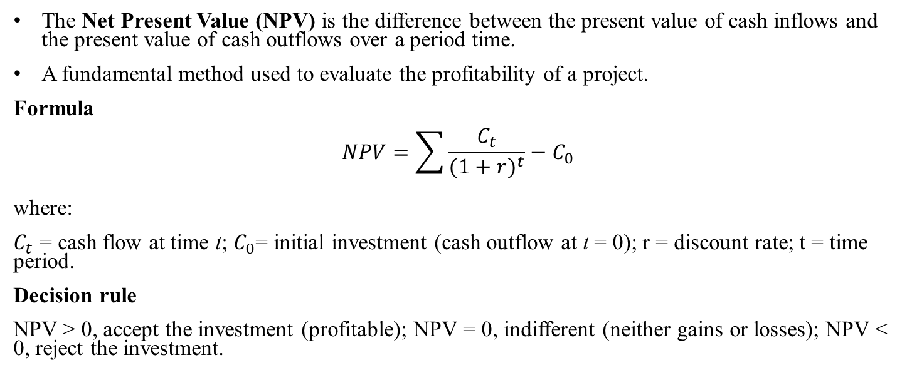
Knowledge review 2
The Net Present Value (NPV) is the difference between the present value of cash inflows and the present value of cash outflows over a period time.
A fundamental method used to evaluate the profitability of a project.
Formula
$$NPV=\sum{\frac{C_{t}}{{(1+r)}^{t}}−C_{0}}$$
where:
$C_{t}$ = cash flow at time t; $C_{0}$= initial investment (cash outflow at t = 0); r = discount rate; t = time period.
Decision rule
NPV > 0, accept the investment (profitable); NPV = 0, indifferent (neither gains or losses); NPV < 0, reject the investment.

Slide 9
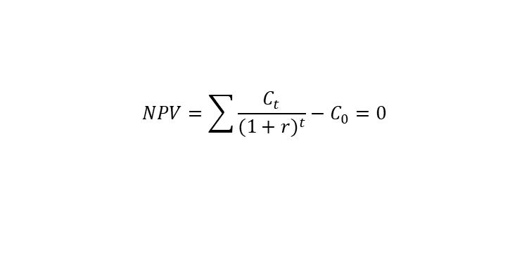
Knowledge review 2
The Internal Rate of Return (IRR) is the discount rate that makes the NPV of all cash flows from a project equal to zero.
It tells you the break-even rate of return.
IRR provides a percentage return, making projects easier to compare.
Formula
Decision rule
If IRR > Required return (cost of return, hurdle rate), accept the project; If IRR = Requirement return, indifference; If IRR < Required return, reject the project.
$$NPV=\sum{\frac{C_{t}}{{(1+r)}^{t}}−C_{0}=0}$$

Slide 10

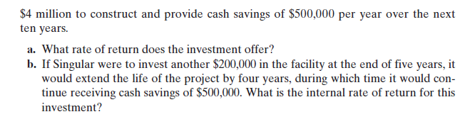
Question 2

Slide 11



Question 2 (cont.)
Answer
a
b
$$NPV=\frac{0.5}{{(1+r)}^{1}}+\frac{0.5}{{(1+r)}^{2}}+…+\frac{0.5}{{\left(1+r\right)}^{10}}−4=0$$
$$IRR \left(r\right)=4.28\%$$
$$NPV=\frac{0.5}{{(1+r)}^{1}}+\frac{0.5}{{(1+r)}^{2}}+…+\frac{\left(0.5−0.2\right)}{{\left(1+r\right)}^{5}}+…+\frac{0.5}{{\left(1+r\right)}^{13}}+\frac{0.5}{{\left(1+r\right)}^{14}}−4=0$$
$$IRR \left(r\right)=7.94\%$$

Slide 12
Question 2 (cont.)
RATE function in Excel
=RATE (nper, pmt, pv, [fv],[type],[guess])
where:
nper is the number of payment period
pmt is the payment per period
pv is the present value of initial investment
[fv] (optional) is the future value
[type] is when payments are made; 0 = end of period (default)
[guess] is an initial guess for the interest rate

Slide 13
Question 2 (cont.)
IRR function in Excel
= IRR (values, [guess])
where:
values = the range of cash flow (including the initial investment, which should be negative).
[guess] (optional) = an initial estimate of the IRR (default is 10%).

Slide 14
Knowledge review 3
Property, plant, and Equipment (PPE) refers to long-term physical assets a company owns and uses in operations, such as buildings, machinery, and equipment.
PPE changes: (1) increases: when a company buys new assets (Capital Expenditure (CAPEX)); (2) decreases: when assets out or become obsolete (depreciation).
Depreciation does not involve actual cash outflows. Instead, it reflects the declining value of PPE.
Formula
$${NetPPE}_{t}={NetPPE}_{t−1}+∆NetPPE$$
$${NetPPE}_{t}={NetPPE}_{t−1}+(CAPEX−Depreciation)$$

Slide 15
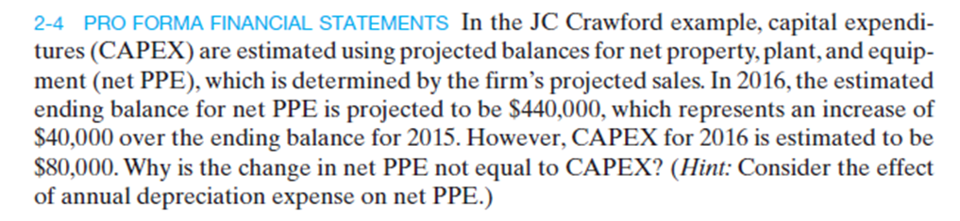
Question 3

Slide 16
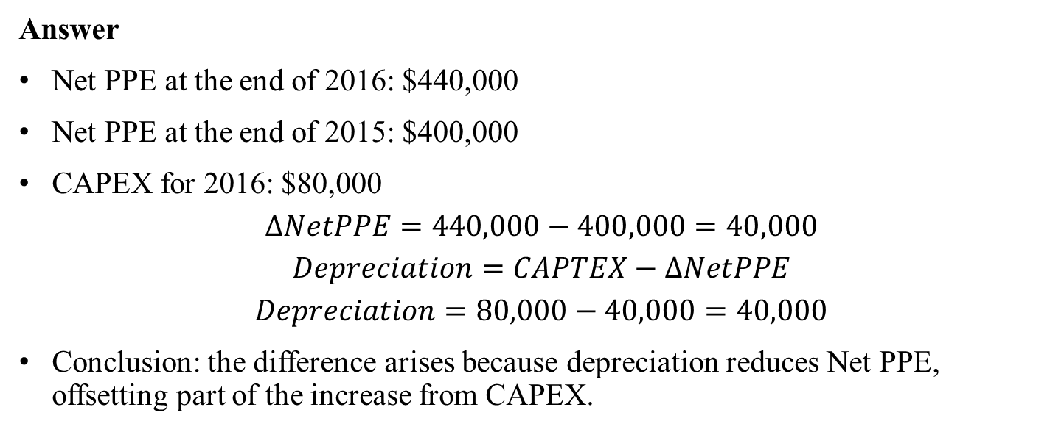
Question 3 (cont.)
Answer
Net PPE at the end of 2016: $440,000
Net PPE at the end of 2015: $400,000
CAPEX for 2016: $80,000
$$∆NetPPE=440,000−400,000=40,000$$
$$Depreciation=CAPTEX−∆NetPPE$$
$$Depreciation=80,000−40,000=40,000$$
Conclusion: the difference arises because depreciation reduces Net PPE, offsetting part of the increase from CAPEX.

Slide 17
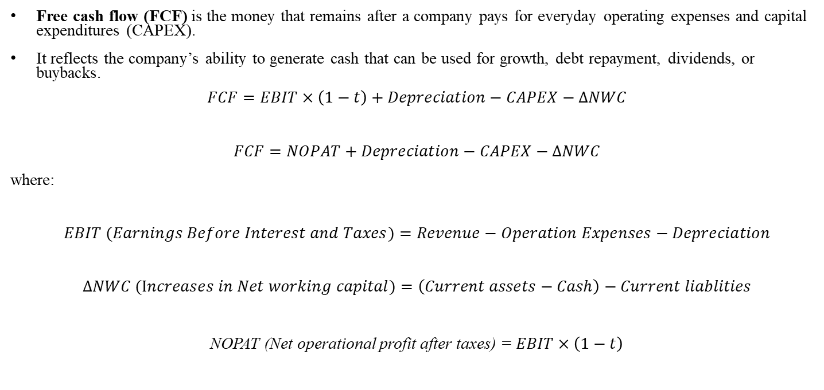
Knowledge review 4
Free cash flow (FCF) is the money that remains after a company pays for everyday operating expenses and capital expenditures (CAPEX).
It reflects the company’s ability to generate cash that can be used for growth, debt repayment, dividends, or buybacks.
$$FCF=EBIT×\left(1−t\right)+Depreciation−CAPEX−∆NWC$$
$$FCF=NOPAT+Depreciation−CAPEX−∆NWC$$
where:
$$EBIT (Earnings Before Interest and Taxes)=Revenue−Operation Expenses−Depreciation$$
$$∆NWC (Increases in Net working capital)=\left(Current assets−Cash\right)−Current liablities$$
NOPAT (Net operational profit after taxes) = $EBIT×\left(1−t\right)$

Slide 18
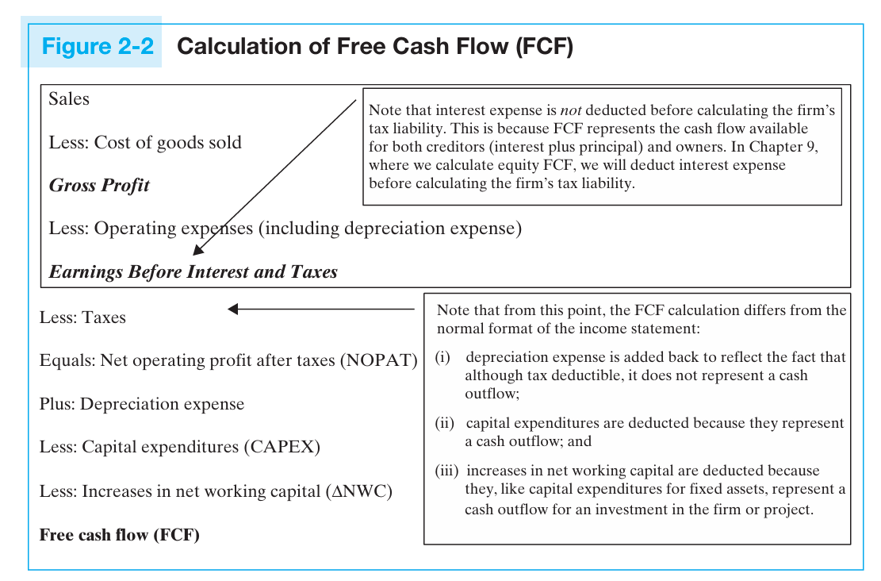
Source: Essential Textbook, Page 25

Slide 19
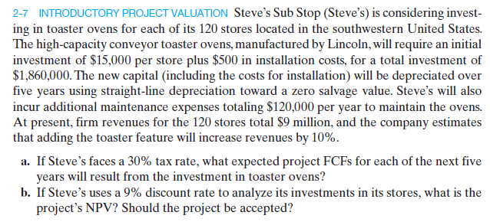
Question 4

Slide 20
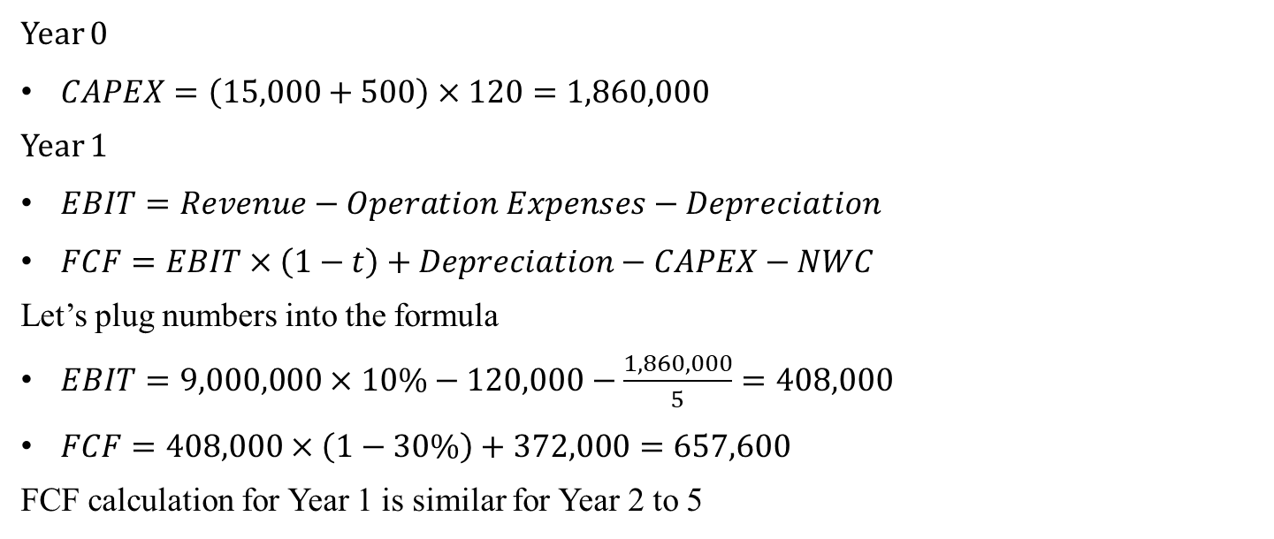
Question 4 (cont.)
Year 0
$CAPEX=\left(15,000+500\right)×120=1,860,000$
Year 1
$EBIT=Revenue−Operation Expenses−Depreciation$
$FCF=EBIT×\left(1−t\right)+Depreciation−CAPEX−NWC$
Let’s plug numbers into the formula
$EBIT=9,000,000×10\%−120,000−\frac{1,860,000}{5}=408,000$
$FCF=408,000×\left(1−30\%\right)+372,000=657,600$
FCF calculation for Year 1 is similar for Year 2 to 5

Slide 21

Question 4 (cont.)
$NPV=−1,860,000+\frac{657,600}{{\left(1+0.09\right)}^{1}}+\frac{657,600}{{\left(1+0.09\right)}^{2}}+\frac{657,600}{{\left(1+0.09\right)}^{3}}+\frac{657,600}{{\left(1+0.09\right)}^{4}}+\frac{657,600}{{\left(1+0.09\right)}^{5}}$
$NPV=697,835>0$
IRR=23% > YOUR expected return (9%)
Accept it!

Slide 22
Question 4 (cont.)
NPV function in Excel
= NPV (rate, value1, [value2])
where:
rate is the discount rate per period
value1 is the future cash flows occurring at the end of each period

